Slide 1
Digital Piano with Practice Mode

Slide 2
Team Number: 2
Team Members:
Zarif Hossain, 170042019
Fahmida Tasnim Lisa, 170042020
Sharmin Naj Mou, 170042074

Slide 3


We made a Digital Piano with Practice Mode using Arduino so that anyone can learn how to play the piano

Slide 4

Features
Digital Piano upto 2 octaves
28 keys piano
Three level of practice mode
Easy
Medium
Hard
Reward system after each level completion

Slide 5
Overview
We made a piano with 2 octaves and a Practice mode where the user can practice hearing and playing notes
The training is in three levels: Easy, Medium and Hard mode.
If the user presses on these training mode buttons, the Piano will make sound of several notes and the user must play the notes similarly as they heard
If the user answers correctly, the green LED will light up and the reward system messages will light up in the LCD screen
Again, if the user plays the wrong notes incorrectly, the red LED will light up and we will also prompt messages on the LCD screen
The LCD screen is also used to display the notes to play

Slide 6
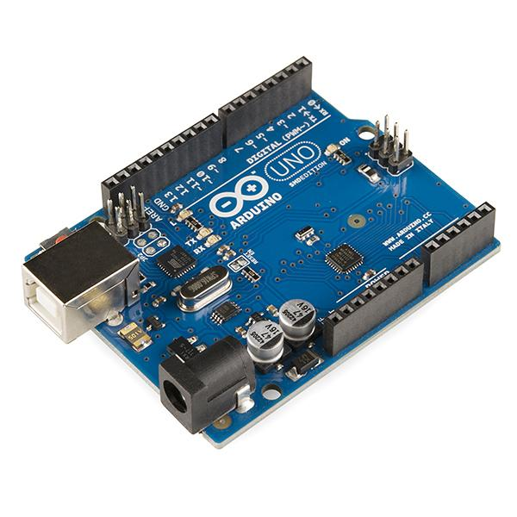
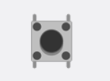
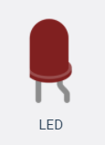

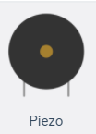
Components
1x Arduino UNO
28x Pushbuttons
Multiple Resistors
1x Piezzo Buzzer
4x Solderless Breadboards
2x LED - Red, Green
1x LCD Screen

Slide 7
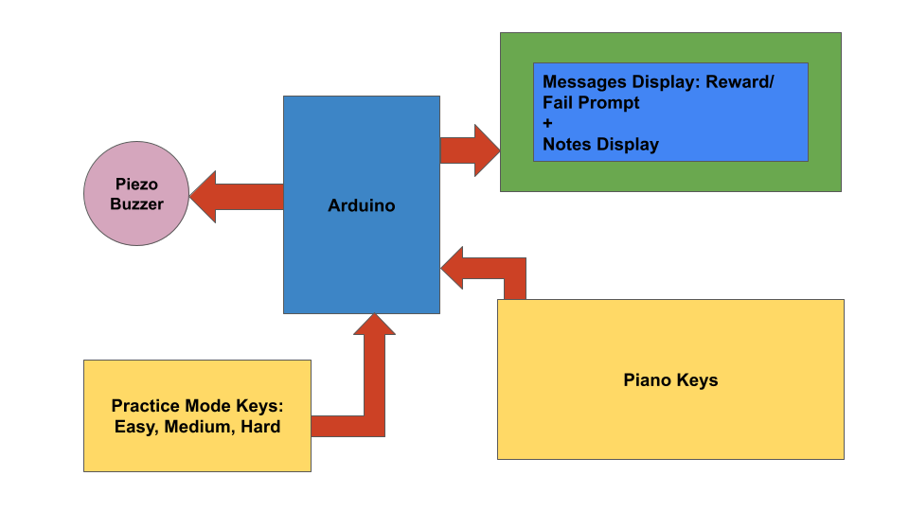
Workflow

Slide 8
DEMO

Slide 9
THANK YOU
Any questions?

